Slide 1
ONLINE PAYMENT OF CUSTOMS DUTY
(SEZ to DTA Bill of Entry Transactions)
Integrated with ICEGATE using API Mechanism

Slide 2
Online Payment of Customs Duty
SEZ to DTA Transaction : Online Payment of Duty is being enabled through ICEGATE and is supported by RBI for collections and Pr.CCA, CBIC for Reconciliations
Start Date : July 1, 2020
Applicability: All DTA Sale Bill of Entry Transactions with Duty Payable
Payment Modes: NEFT / RTGS
Facility: No need for payment at bank counter, automatic updation of challans in Bill of Entry
Function | Role
Bill of Entity – Filing, Assessment, Challan Generation | SEZ Online
Online Payment Facilitation – NEFT/RTGS Mandate, RBI Connectivity | ICEGATE
Challan Reporting to PCCA | ICEGATE
Funds Collection & Reporting | RBI
Reconciliation & Reporting | PCCA
Payment Status Updation | ICEGATE / SEZ Online

Slide 3
Process of Online Payment of Customs Duty
DTA Sale Request Assessment in SEZ Online System [Challan Generation]
Online Payment confirmation by SEZ Entity in SEZ Online System
Sharing of Challan Details by SEZ Online System to ICEGATE.
Accessing ICEGATE to view Challans and Initiate Payment
RBI will provide electronic confirmation to ICEGATE
Pay duty payment using NEFT/RTGS mode by Quoting “Account Number” & “IFSC” mentioned in Mandate Form.
Generation of NEFT Mandate
ICEGATE will provide confirmation to SEZ Online.
Upon receipt of Success payment message from ICEGATE, Bill of Entry transaction will move to Customs Authorised Officer for “Out of Charge”

Slide 4
DTA Sale transaction details captured in SEZ Online System
Generation of Mandate Form
Duty payment using NEFT/RTGS mode
(Assessment of DTA Sale transaction in SEZ Online System and generation of Challan Number)
Confirmation for Online Duty Payment
SEZ Online System User / DTA Unit (only duty payment)
Sharing of Challan Information by SEZ Online System to ICEGATE
ICEGATE will in turn provide the confirmation to SEZ Online System.
SEZ Online System
ICEGATE
RBI to provide electronic confirmation to ICEGATE.
The corresponding DTA Sale transaction will move to Authorised Officer’s inbox for Out of Charge.
Payment will be received in the account of Principal CCA office which is maintained by RBI.

Slide 5
Online Payment of Customs Duty
Sr. | Stage of Bill of Entry | Details
1 | Bill of Entry Creation, Submission, Assessment | No change
2 | Duty Payment – Options | Additional facility of Online Duty Payment, if chosen Challan will be sent to ICEGATE System for online payment.
3 | Visit ICEGATE to Pay | Select SEZ Name, enter IEC/PAN of DTA buyer to fetch challans. View unpaid challans. Single or multiple challans (Max.10) can be selected for duty payment.
4 | Generation of Mandate form | After, Confirm and Pay screen, generate “Mandate Form” with NEFT or RTGS option. Mandate Form to be generated and printed/saved.
6 | Duty Payment | Pay duty using NEFT/RTGS by Quoting “IFSC”, “Account Number” & “Account Name” as per Mandate Form. NEFT / RTGS transfer can be made from any bank, using online banking or branch banking facilities offered by such bank.
7 | Updation of Duty Payment Status | NEFT / RTGS payment of challan is credited to duty collection account of Principal CCA, maintained at RBI. RBI will send successful credit details to ICEGATE and ICEGATE will send confirmation to SEZ Online.
8 | Out of Charge | Duty payment receipt received from ICEGATE will be attached to Bill of Entry and forwarded to Preventive Officer for “Out of Charge”

Slide 6
Process of Online Duty Payment
Facility for Online Duty payment will be enabled when below transaction is approved by SEZ Customs with below System Statuses:
Approved with Duty:
Approved with Duty (GST):
Approved with Duty (Provisional):
Approved with Duty (GST)(Provisional)
Final Assessment Completed – Pay Duty
Online duty payment option needs to be selected as below:

Slide 7
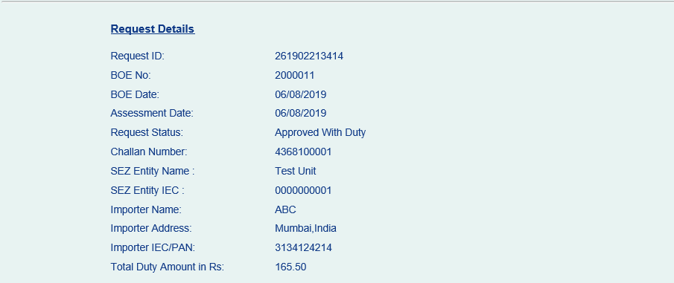
Request ID to fetch BoE Information

Slide 8
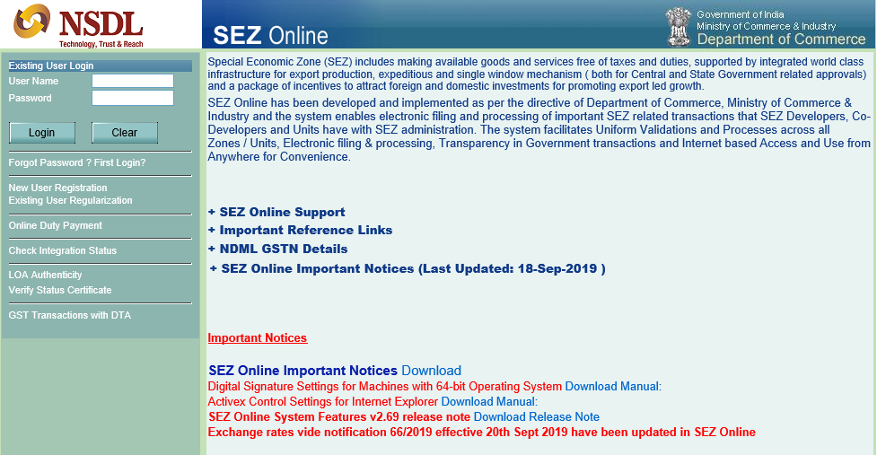
Confirmation of Online Duty Payment by DTA
DTA company can access Challan as below & confirm without need of Login

Slide 9
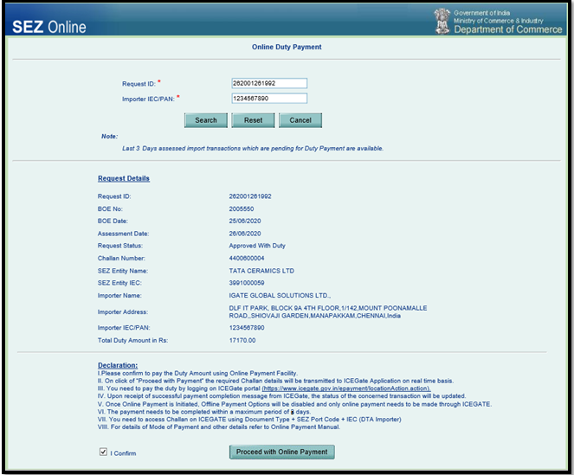

Slide 10
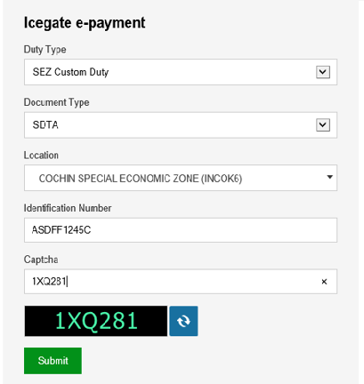
Challan Access & Payment on ICEGATE portal Link: https://cbicpay.icegate.gov.in/iceepay/
DTA IEC/PAN

Slide 11
Challan Confirmation & Generation of Mandate Form

Slide 12
Important Points to be Noted
Transfer can be made from any bank participating in NEFT / RTGS System. The payment is being managed through RBI account and therefore the IFSC Code belongs to RBI directly.
The account number generated on the mandate form is a Virtual Account Number and will change for each transaction and cannot be re-used.
Absolute care should be taken to ensure that IFSC Code and Account Number, as are provided on the mandate form are correctly captured in funds transfer instruction.
It is suggested to Print and also save a copy of the mandate form as generated from ICEGATE system for future reference.

Slide 13
Important Points to be Noted Contd…
Payment must be completed (including multiple levels of authorisation) well before the expiry date and time indicated on the mandate form.
NEFT / RTGS transaction reference number received from your banker may be maintained for further reference.
In case where multiple challans are selected for consolidated payment, the duty amount would be total of all challans.
Note: Facility for payment using Net banking would be introduced in due course and will be intimated to all users.

Slide 14
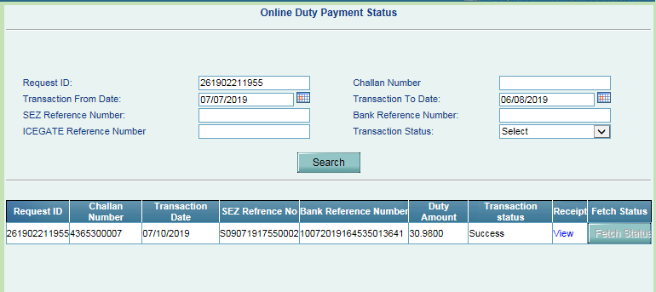
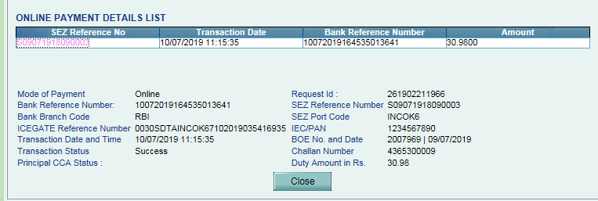
Duty Payment Status & Acknowledgement

Slide 15
Important Online Duty Payment Instructions
Timelines for Online Payment of Customs Duty:
Online Payment option to be opted within 3 days of Assessment
Payment to be completed within 5 days of Assessment.
Adherence to details on Mandate Form:
Correctness of Account Number, IFSC, Challan Validity date to be ensured.
Provisional to Final Assessment: Additional duty on account of rise in duty amount on account Final Assessment can be paid using Online Duty Payment Facility
Amendment of Transactions: When provisionally assessed BoE is presented for final assessment and if it results in increase in duty then user will get an option of payment using online duty payment facility and process explained above for online duty payment will apply.

Slide 16
Important Online Duty Payment Instructions Contd…
Refund of duty: If amendment / cancellation / finalisation results in decrease in duty then existing procedures for claiming refund needs to be followed and there will be no procedure for online refund through SEZ Online System.
Facility for Advance Duty Payment: Facility for Payment using Advance Duty will be disabled once online payment module gets streamlined and in consultation with DoC and Principal CCA. Balance deposited so far me be utilised.
TR-6 Challan based payments: Will be disabled once online payment module gets streamlined.

